Slide 1
RESUME WRITING: STRUCTURE AND TYPES

Slide 2
WHAT IS RÉSUMÉ?
Résumé is a French word that means ‘summary’.
Although in English it is used to refer to ‘an account or a summary of something’, its popular use is limited to mean ‘a brief account of an applicant’s details to procure a job.’
‘Résumé’, pronounced as ‘razume’, should not be confused with the word ‘resume’, uttered as ‘rizum’, which distinctly means ‘to begin again’.
It is the first item that an employer encounters regarding the job seeker to shortlist him/her for a job interview. Therefore, the primary aim of a résumé is to get a call for an interview, although securing the job is the ultimate objective.

Slide 3
HOW DOES IT DIFFER FROM A CV?
CV is a traditional method of presenting personal data, while résumé evolved much later.
A résumé is normally used for seeking employment in business, finance and HR fields, especially in the private sector, whereas a CV is helpful while applying for academic, scientific, research, medical, university, fellowship and other educational positions.
A résumé is brief and concise—not more than a page or two. A CV is a longer version, a more detailed synopsis, extending up to four to five pages, perhaps more, in case annexure is attached.
By and large, a résumé has a freestyle and customarily enumerates a candidate’s data in reverse chronological order, while a CV conveys chronologically arranged information.
A résumé highlights only the relevant credentials, while a CV provides a comprehensive summary of an applicant’s personal, educational and career details.

Slide 4
ATTRIBUTES OF A GOOD RÉSUMÉ
A good résumé has the following major attributes:
➙ Designed for a specific post, arouses interest in the reader.
➙ Well displayed with proper formatting, spacing and sufficient white space.
➙ Factual, correct and complete.
➙ Information is categorized under headings and columns.
➙ Uses appropriate concise style rather than using ‘I’ repeatedly.
➙ Coherent, uniform and brief in presentation (preferably not more than one to two pages).
➙ Does not make overstated assertions.
➙ Highlights relevant areas starting from the recent ones.
➙ Uses right words, grammar, spelling and punctuation.

Slide 5
TYPES: CHRONOLOGICAL, FUNCTIONAL AND COMBINATION

Slide 6
CHRONOLOGICAL RÉSUMÉ
This is the most commonly used format.
It gives the data in a reverse chronological order, as the employers today are more interested in your recent achievements.
Such résumés go well for both a fresher and a beginner.

Slide 7
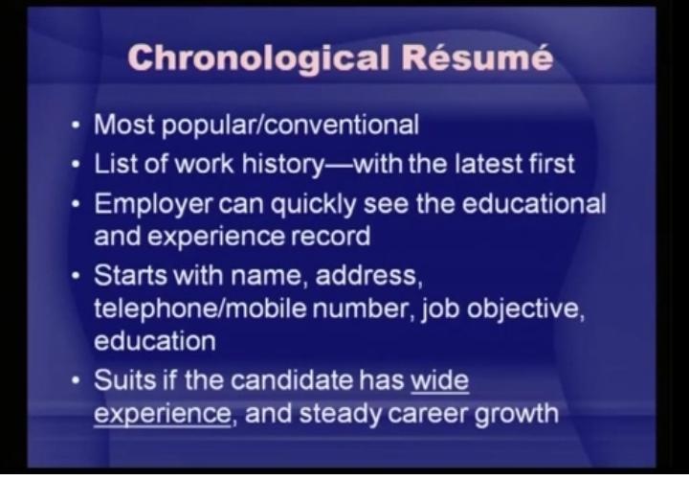

Slide 8
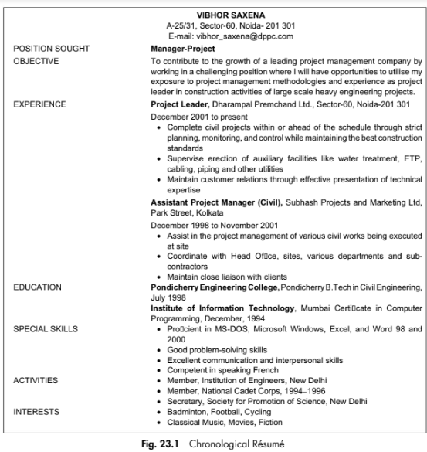
CHRONOLOGICAL RÉSUMÉ

Slide 9
FUNCTIONAL RÉSUMÉ
This is basically a skill profile that is used to focus on abilities that are specific to the type of position sought for.
These résumés present details skill wise.
They are suitable for those who want to change their career, have a wide work experience or are applying for jobs that require clearly defined profile and personality traits.

Slide 10
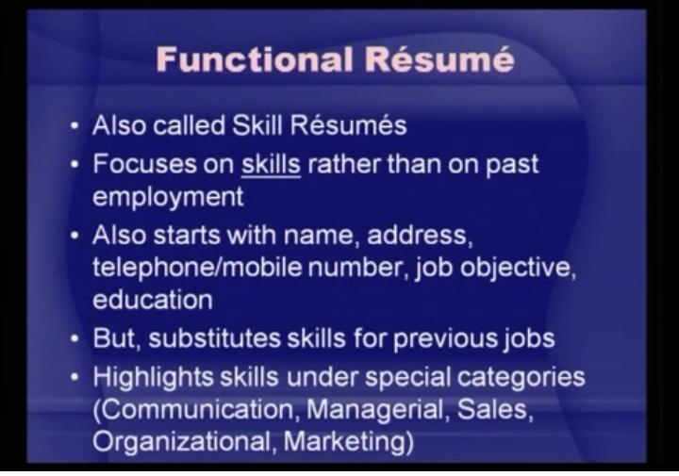

Slide 11
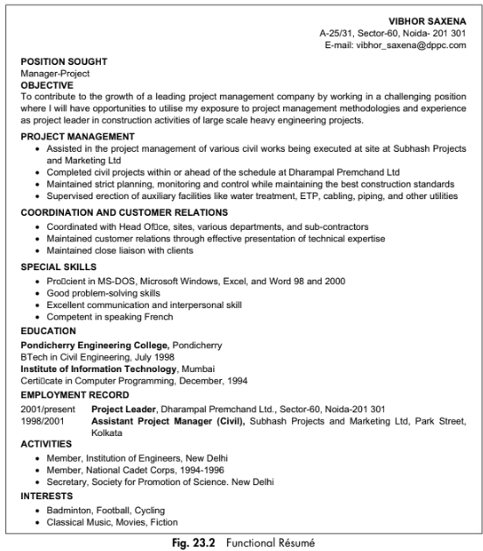
FUNCTIONAL RÉSUMÉ

Slide 12
COMBINED RÉSUMÉ
It includes elements of both the chronological and functional formats.
It may be a shorter chronology of job descriptions preceded by a short ‘Skills and Accomplishments’ section (or with a longer summary including a skills list or a list of ‘qualifications’).
It may be a standard functional résumé with the accomplishments under headings of different jobs held.

Slide 13
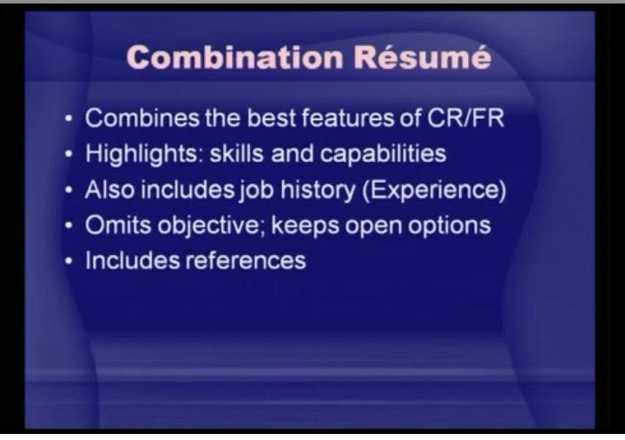

Slide 14
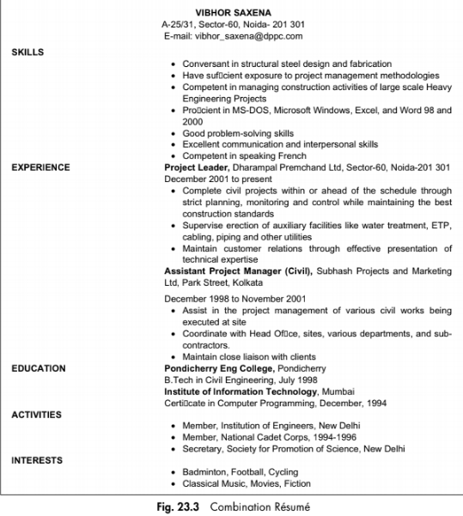
COMBINED RÉSUMÉ

Slide 15
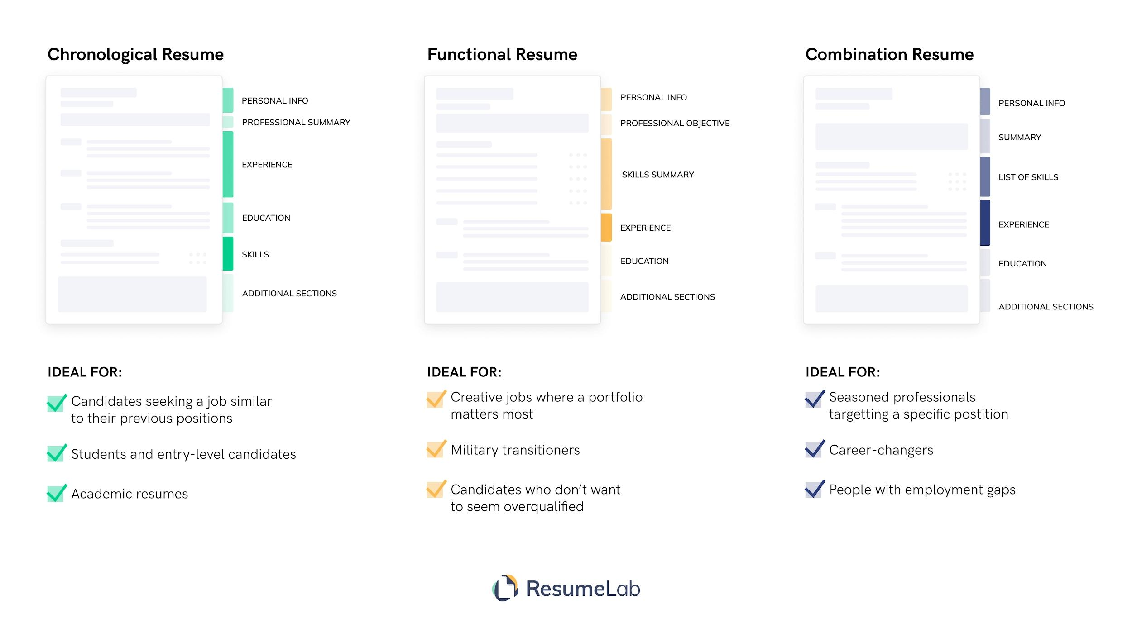
TYPES

Slide 16
STRUCTURE
It can be divided into three major parts—
the opening,
the middle and
the closing

Slide 17
(A) THE BEGINNING
Headline: Begins with a headline giving: Name, address, e-mail ID, Tel, no., and fax no.
Desired Position: stated
Career Objective: One sentence—statement of career goals—job specific and not vague, need not be in high-flown English, communicates self-motivation and interest. (for specific/targeted position)
Specimen: To work on a suitable position in a prestigious Electrical Component Production Set-up, where I can learn with experience, utilize my existing skills and grow in my relevant field, contributing to the development of the organization.
To work with a progressive organization and to contribute the best for organization through my hardworking and sincere approach.
Four years of experience as production engineer with thorough understanding of weld technology and design and sound knowledge about trouble-shooting, fool proofing of processes, cost saving through process improvement, and low cost automation.

Slide 18
(B) THE MIDDLE:
This is the functional segment of your document and should be designed very carefully as the major part of your interview deals with the data given here.
4. Work Experience: Only relevant work experience 5. Education: Relevant qualifications, trainings, etc., are mentioned. (Highlight your educational details if you are a new job applicant.).
6. Skills and Personality Traits: Only special skills suitable to the targeted position are listed, for example, expertise in a related computer language/data processing/knowledge of foreign languages/interpersonal skills/leadership qualities. 7. Achievements: Only concerned achievements are listed or those that differentiate you from others and show that you are a go-getter and can take challenges. -- Employers are interested in your work experience, professional skills and achievements as such things give you an edge over the others. Support such information with relevant documents and facts.

Slide 19
(C) THE CLOSING:
8. Activities and Interest: Extra/co-curricular activities/hobbies, memberships, participation in sports, seminars, exhibitions, quizzes, academic and cultural competitions (only special items briefly and in points) 9. Personal: — age, nationality, driving license and passport no., married/unmarried*; children* (optional) 10. References: 2–3 names of referees ( holding a responsible position) who can recommend your name for the concerned post. Names, designations, addresses, and telephone nos. should be given.

Slide 20
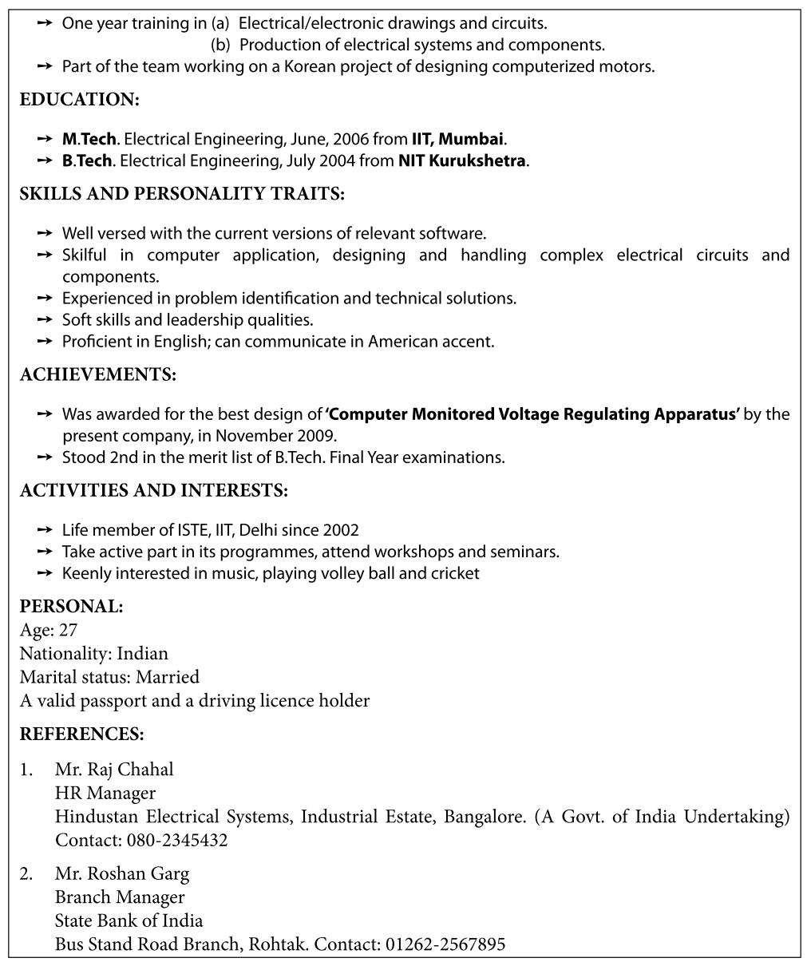
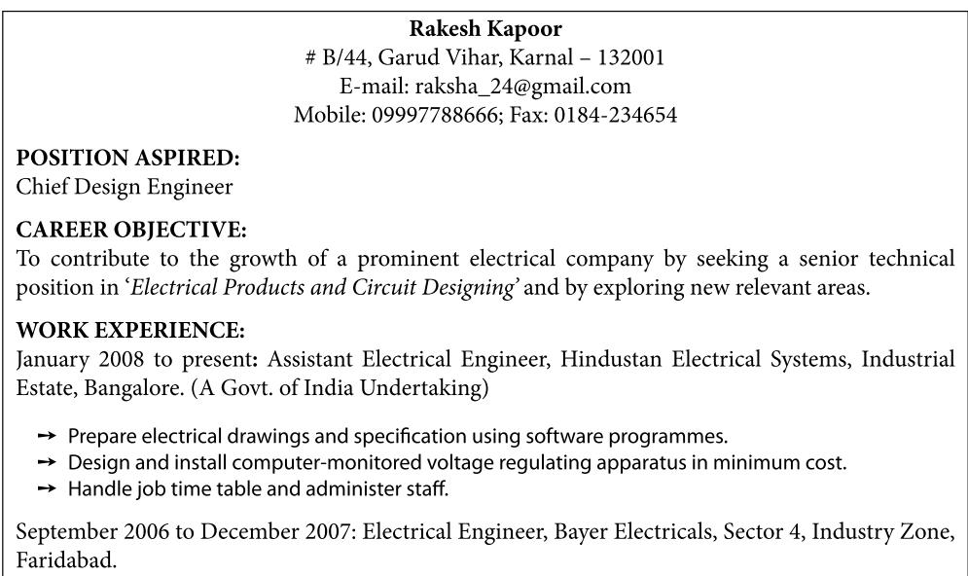
SPECIMEN OF AN EXPERIENCED APPLICANT

Slide 21
RÉSUMÉ FOR A FRESH APPLICANT
In the absence of experience, employers would be more interested in aspects such as training, projects,
education, skills and achievements. The layout of the Résumé for a new candidate is not much different.
However, there is a difference in approach and may vary in its presentation.

Slide 22
RÉSUMÉ FOR A FRESH APPLICANT
(a) Career Objective: Express your broad career goals, type of task you would like to do and
willingness to learn.
(b) Training: Mention about your training highlighting the training field and what you have gained
from it. Use sentences such as ‘Received three months training, at …, from … to …, in the field of ….’
Gained knowledge on ….
(c) Education: Provide this information in a little detail, that is, starting from the current; you may
go back to matriculation.
(d) Skills and Strengths: At this stage as you cannot be very specific, mention your general
capabilities and traits relevant to the position, for example, proficient in C++, Excel, Java and MAT
Lab/very good at maths and English/logical reasoning/ability to co-relate theory with practical/
communication skills/leadership qualities/problem solving skills/keen to learn and so on.
(e) Achievements, Activities and Interests: These should be emphasized as companies
want people who are all rounders, self-motivated, have a positive attitude and are eager to take
challenges.

